Slide 1
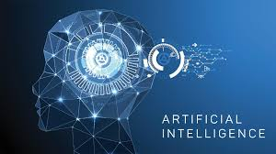
Artificial Intelligence
Md. Adnin Masrif 161-35-1530

Slide 2
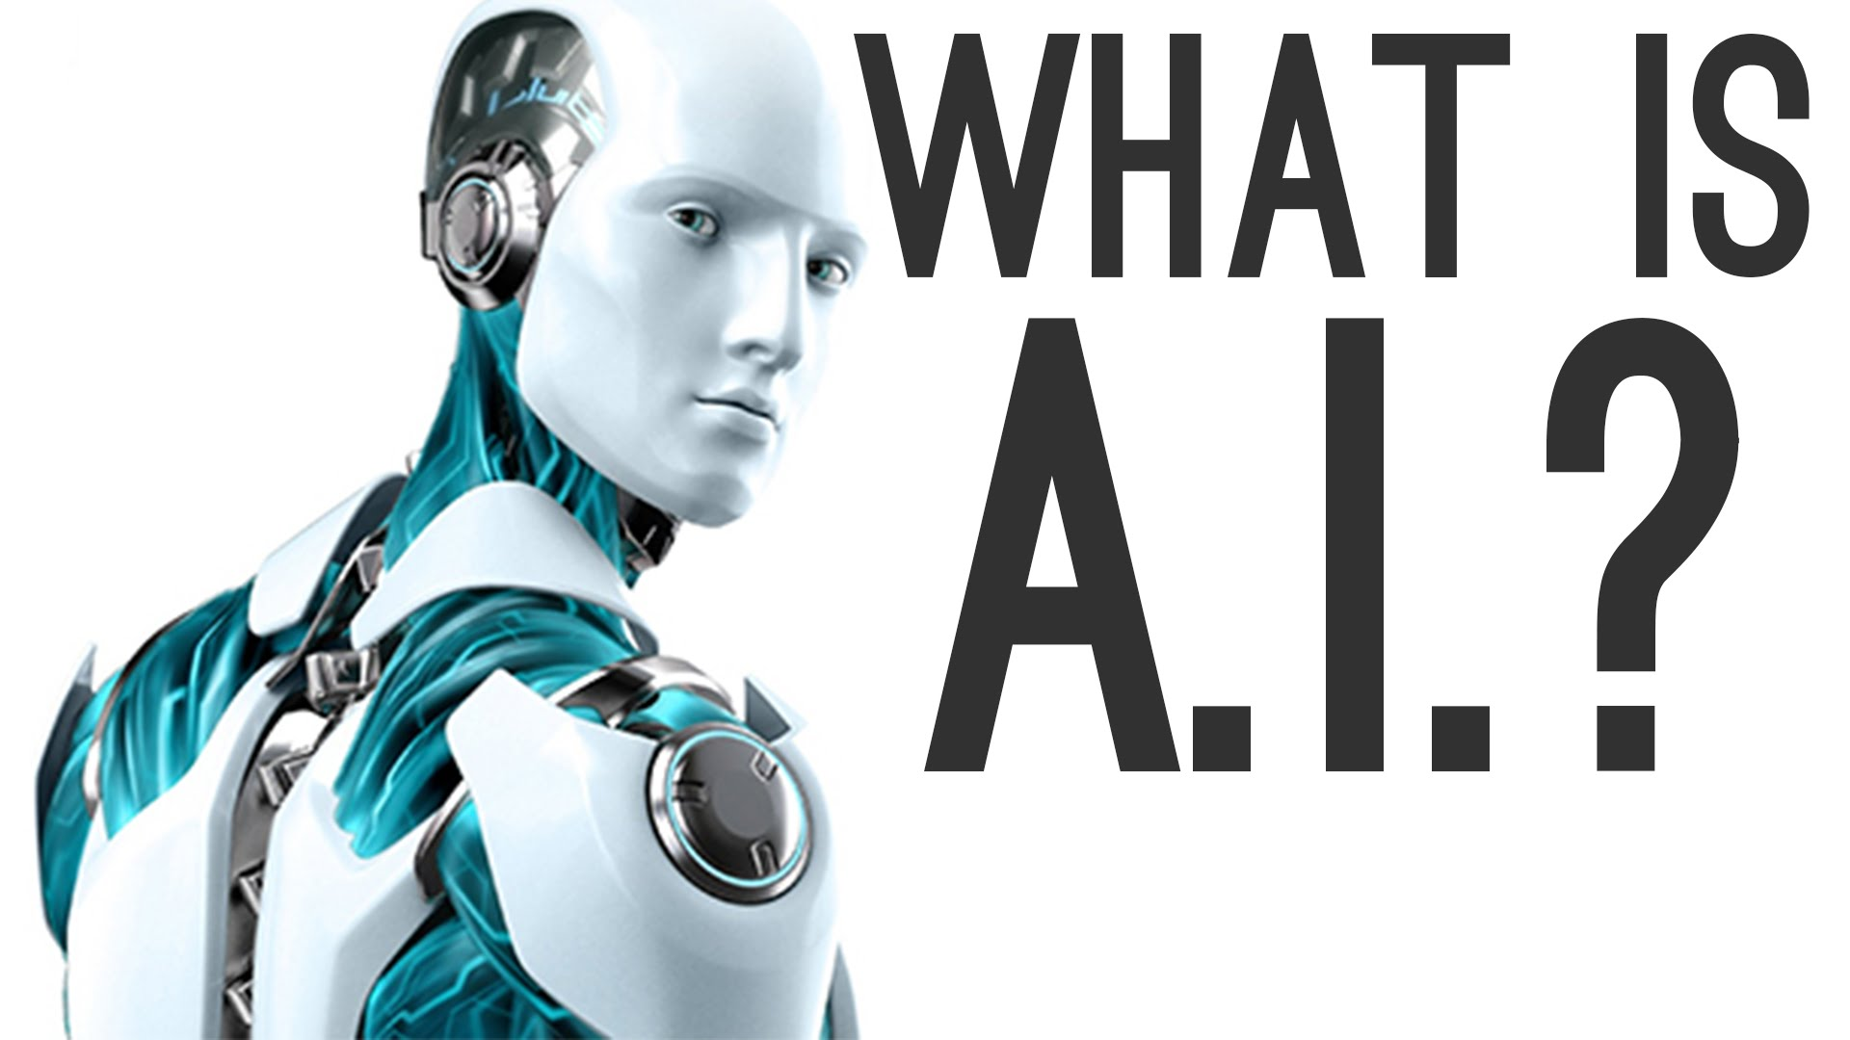
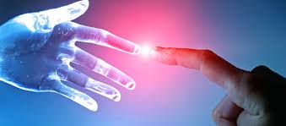
Artificial Intelligence

Slide 3
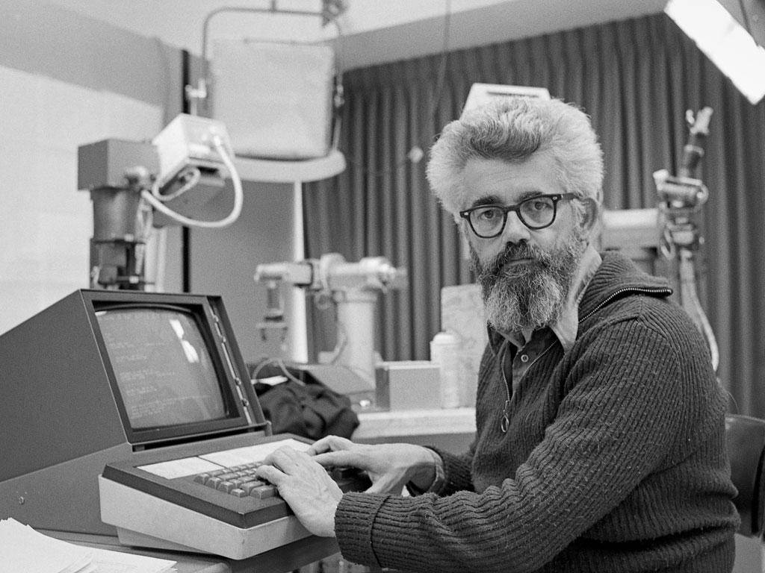
Artificial Intelligence
“The science and engineering of making intelligent machines, especially intelligent computer programs”
John McCarthy(1927-2011)

Slide 4
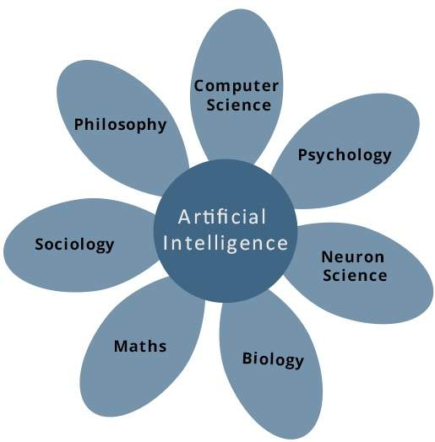
Contributors

Slide 5
Goals of A.I.
To Create Expert Systems − The systems which exhibit intelligent behavior, learn, demonstrate, explain, and advice its users.
To Implement Human Intelligence in Machines − Creating systems that understand, think, learn, and behave like humans.

Slide 6
Applications
Expert Systems − There are some applications which integrate machine, software, and special information to impart reasoning and advising.
Examples: Flight-tracking systems, Clinical systems.
Natural Language Processing − It is possible to interact with the computer that understands natural language spoken by humans. Examples: Google Now feature.
Gaming − AI plays crucial role in strategic games such as chess, poker, tic-tac-toe, etc., where machine can think of large number of possible positions based on heuristic knowledge.

Slide 7
Applications
Vision Systems − These systems understand, interpret, and comprehend visual input on the computer. For example,
A spying airplane takes photographs, which are used to figure out spatial information or map of the areas.
Doctors use clinical expert system to diagnose the patient.
Police use computer software that can recognize the face of criminal with the stored portrait made by forensic artist

Slide 8
Applications
Speech Recognition − It can handle different accents, slang words, noise in the background, change in human’s noise due to cold, etc.
Handwriting Recognition − The handwriting recognition software reads the text written on paper by a pen or on screen by a stylus. It can recognize the shapes of the letters and convert it into editable text.
Robotics −
Examples − Industrial robots for moving, spraying, painting, drilling, cleaning, coating, carving, etc.

Slide 9
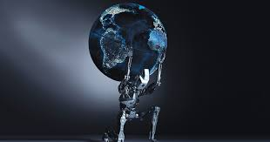
Risks of A.I.
The AI is programmed to do something devastating
The AI is programmed to do something beneficial, but it develops a destructive method for achieving its goal

Slide 10
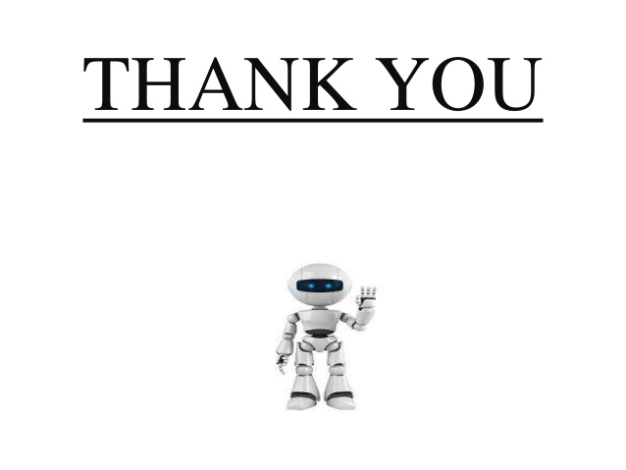
Artificial Intelligence

